Slide 1
Market Structure (Oligopoly)

Slide 2
Game

Slide 3

Market Structures
Market Structure
Oligopoly
Perfect Competition
Monopoly
number of firms

Slide 4
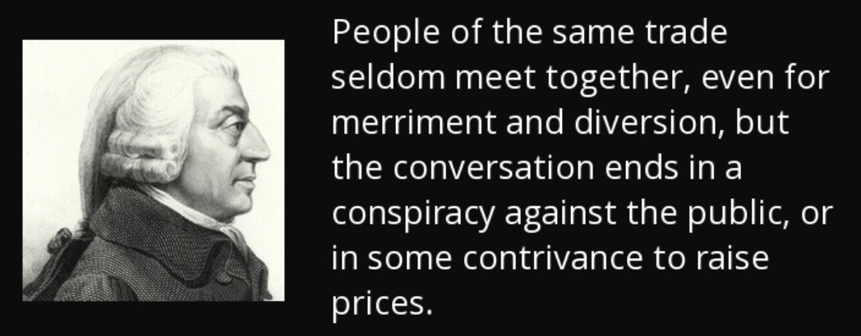
Collusion
Market Structure
Oligopoly
Perfect Competition
Monopoly
number of firms

Slide 5
Collusion Examples?
Market Structure

Slide 6
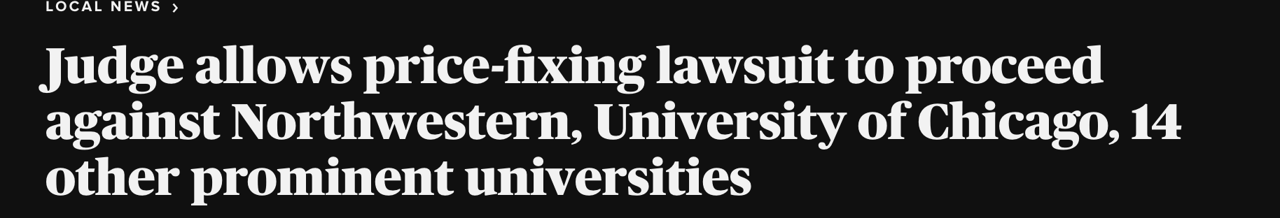
Collusion Examples?
Market Structure

Slide 7
Microeconomics for Business
Chapter 9 – Game Theory Part 1 (Static Games)
Bertrand Competition

Slide 8
Bertrand Competition
Bertrand game:
Each firm chooses the price of its own good

Slide 9
Bertrand Competition
Bertrand game:
Each firm chooses the price of its own good
Firms make this choice simultaneously

Slide 10
Bertrand Competition
Bertrand game:
Each firm chooses the price of its own good
Firms make this choice simultaneously
Firms produce homogeneous products

Slide 11
Bertrand Competition
Bertrand game:
Each firm chooses the price of its own good
Firms make this choice simultaneously
Firms produce homogeneous products
All consumers will purchase from the cheaper firm

Slide 12
Bertrand Competition
Bertrand game:
Each firm chooses the price of its own good
Firms make this choice simultaneously
Firms produce homogeneous products
All consumers will purchase from the cheaper firm
If same price, then consumers will evenly split their demand

Slide 13
Bertrand Competition
Bertrand game:
Each firm chooses the price of its own good
Firms make this choice simultaneously
Firms produce homogeneous products
All consumers will purchase from the cheaper firm
If same price, then consumers will evenly split their demand
Duopoly: only two firms produce the good in this market

Slide 14
Bertrand Competition
Example:
Firm 1 and Firm 2 are fast-food restaurants

Slide 15
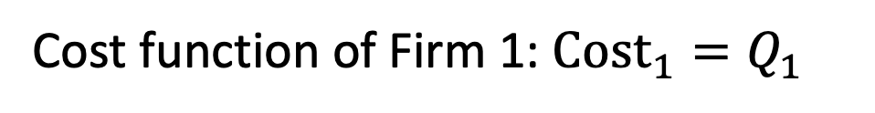
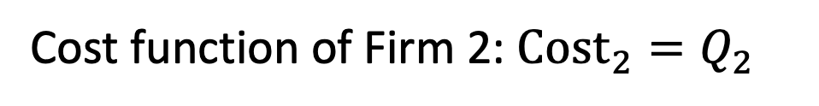
Bertrand Competition
Example:
Firm 1 and Firm 2 are fast-food restaurants

Slide 16


Bertrand Competition
Example:
Firm 1 and Firm 2 are fast-food restaurants

Slide 17
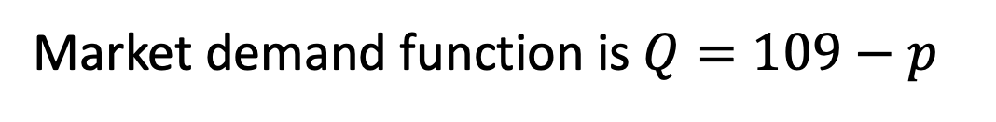
Bertrand Competition
Example:

Slide 18


Bertrand Competition
Example:

Slide 19
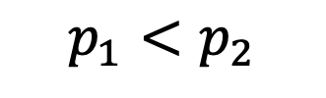


Bertrand Competition
Example:

Slide 20
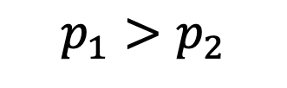


Bertrand Competition
Example:

Slide 21
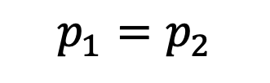
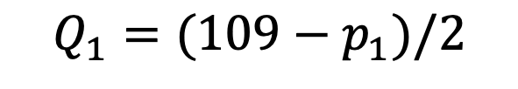
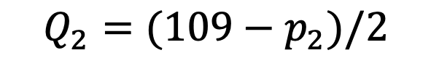
Bertrand Competition
Example:

Slide 22
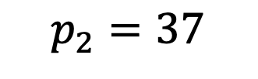
Bertrand Competition
Example:
Firm 2
Firm 1

Slide 23
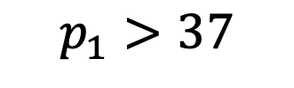
Bertrand Competition
Example:
Firm 2
Firm 1
(not optimal)

Slide 24
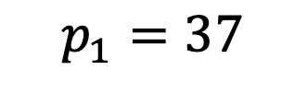
Bertrand Competition
Example:
Firm 2
Firm 1
(not optimal)
(not optimal)

Slide 25
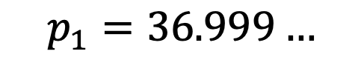
Bertrand Competition
Example:
Firm 2
Firm 1
(not optimal)
(not optimal)
(optimal)

Slide 26
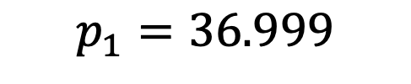
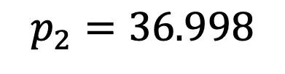
Bertrand Competition
Example:
Firm 2
Firm 1

Slide 27
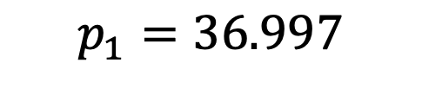
Bertrand Competition
Example:
Firm 2
Firm 1

Slide 28
Bertrand Competition
Example:
Firm 2
Firm 1

Slide 29


Bertrand Competition
Example:
Firm 2
Firm 1

Slide 30
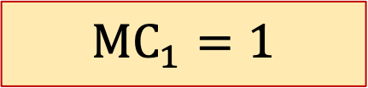
Bertrand Competition
Example:
Firm 2
Firm 1

Slide 31


Bertrand Competition
Example:
Firm 2
Firm 1
Nash Equilibrium

Slide 32
Bertrand Competition
Example:
Firm 2
Firm 1
Nash Equilibrium

Slide 33
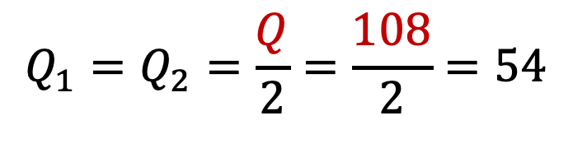
Bertrand Competition
Example:
Firm 2
Firm 1
Nash Equilibrium

Slide 34
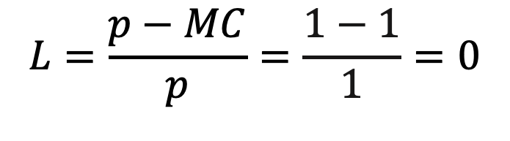
Bertrand Competition
Example:
Firm 2
Firm 1
Nash Equilibrium

Slide 35
Microeconomics for Business
Chapter 9 – Game Theory Part 1 (Static Games)
Cournot Competition

Slide 36
Cournot Competition
Cournot game (1838)
Model to study competition between firms.

Slide 37
Cournot Competition
Cournot game (1838)
Model to study competition between firms.
Competing firms produce the same good.

Slide 38
Cournot Competition
Cournot game (1838)
Model to study competition between firms.
Competing firms produce the same good.
Each firm chooses the quantity of the good it will produce.

Slide 39
Cournot Competition
Cournot game (1838)
Model to study competition between firms.
Competing firms produce the same good.
Each firm chooses the quantity of the good it will produce.
Firms make their choices simultaneously.

Slide 40
Cournot Competition
Cournot game (1838)
Market price is a decreasing function of the total amount of goods produced by the firms

Slide 41
Cournot Competition
Cournot game (1838)
Market price is a decreasing function of the total amount of goods produced by the firms
Each firm produces the quantity that maximizes its own profit.

Slide 42
Cournot Competition
Cournot game (1838)
Market price is a decreasing function of the total amount of goods produced by the firms
Each firm produces the quantity that maximizes its own profit.
Duopoly: only two firms produce the good

Slide 43
Cournot Competition
Example:
Firm 1 and Firm 2 produce soybeans

Slide 44
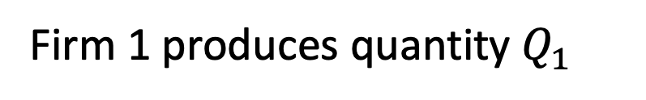
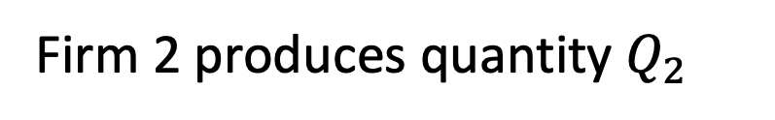
Cournot Competition
Example:
Firm 1 and Firm 2 produce soybeans

Slide 45
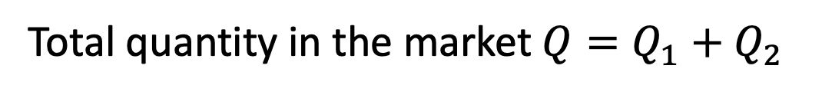
Cournot Competition
Example:
Firm 1 and Firm 2 produce soybeans

Slide 46
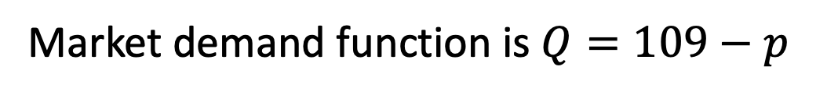
Cournot Competition
Example:

Slide 47

Cournot Competition
Example:
(inverse demand)

Slide 48

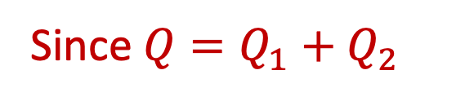


Cournot Competition
Example:

Slide 49
Cournot Competition
Example:
Cost function of Firm 1: Cost₁=13Q₁
MC₁=13
Cost function of Firm 2: Cost₂=13Q₂
MC₂=13

Slide 50
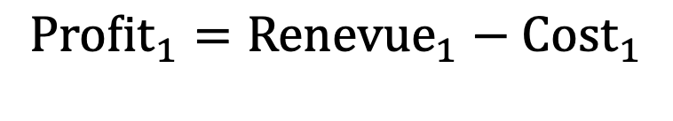
Cournot Competition
Example:
Cost function of Firm 1: Cost₁=13Q₁
MC₁=13
Cost function of Firm 2: Cost₂=13Q₂
MC₂=13

Slide 51
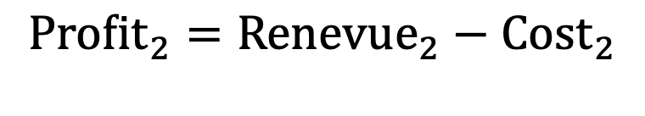
Cournot Competition
Example:
Cost function of Firm 1: Cost₁=13Q₁
MC₁=13
Cost function of Firm 2: Cost₂=13Q₂
MC₂=13
Profit₁=pQ₁-13Q₁
Profit₂=pQ₂-13Q₂

Slide 52

Cournot Competition
Example:
Profit₁=pQ₁-13Q₁
(inverse demand)

Slide 53
Cournot Competition
Example:
Profit₁=pQ₁-13Q₁
(inverse demand)
Profit₁=(109-Q₁-Q₂)Q₁-13Q₁

Slide 54
Cournot Competition
Example:
Profit₁=pQ₁-13Q₁
(inverse demand)
Profit₁=(109-Q₁-Q₂)Q₁-13Q₁
Profit₁=109Q₁-Q₁²-Q₁Q₂-13Q₁
Profit₁=96Q₁-Q₁²-Q₁Q₂

Slide 55
Cournot Competition
Example:
Profit₂=pQ₂-13Q₂
(inverse demand)
Profit₂=(109-Q₁-Q₂)Q₂-13Q₂
Profit₂=109Q₂-Q₂²-Q₁Q₂-13Q₂
Profit₂=96Q₂-Q₂²-Q₁Q₂

Slide 56
Cournot Competition
Example:
Profit₁=96Q₁-Q₁²-Q₁Q₂
Profit₂=96Q₂-Q₂²-Q₁Q₂

Slide 57
Cournot Competition
Example:
Profit₁=96Q₁-Q₁²-Q₁Q₂

Slide 58
Cournot Competition
Example:
Profit₁=96Q₁-Q₁²-Q₁Q₂
∂Profit₁/∂Q₁=96-2Q₁-Q₂

Slide 59
Cournot Competition
Example:
Profit₁=96Q₁-Q₁²-Q₁Q₂
F.O.C.
∂Profit₁/∂Q₁=96-2Q₁-Q₂
96-2Q₁-Q₂=0

Slide 60
Cournot Competition
Example:
Profit₁=96Q₁-Q₁²-Q₁Q₂
F.O.C.
∂Profit₁/∂Q₁=96-2Q₁-Q₂
96-2Q₁-Q₂=0
96-Q₂=2Q₁
48-0.5Q₂=Q₁
Best Response Function of Firm 1 (BR₁):

Slide 61
Cournot Competition
Example:
Profit₂=96Q₂-Q₂²-Q₁Q₂
F.O.C.
∂Profit₂/∂Q₂=96-2Q₂-Q₁
96-2Q₂-Q₁=0
96-Q₁=2Q₂
48-0.5Q₁=Q₂
Best Response Function of Firm 2 (BR₂):

Slide 62
Cournot Competition
Example:
48-0.5Q₂=Q₁
48-0.5Q₁=Q₂

Slide 63
Cournot Competition
Example:
48-0.5Q₂=Q₁
Q₁=32
Q₂=32
48-0.5Q₁=Q₂

Slide 64
Cournot Competition
Example:
Q₁=32
Q₂=32
Q=Q₁+Q₂=32+32=64

Slide 65
Cournot Competition
Example:
Q₁=32
Q₂=32
Q=Q₁+Q₂=32+32=64
P=109-Q₁-Q₂=109-64=45

Slide 66
Cournot Competition
Example:
Q₁=32
Q₂=32
Q=Q₁+Q₂=32+32=64
P=109-Q₁-Q₂=109-64=45
Profit₁=pQ₁-13Q₁=45x32-13x32=$1,024

Slide 67
Cournot Competition
Lerner Index= (p-MC)/p=
(45-13)/45=0.711
Example:
Q₁=32
Q₂=32
Q=Q₁+Q₂=32+32=64
P=109-Q₁-Q₂=109-64=45
Profit₁=pQ₁-13Q₁=45x32-13x32=$1,024

Slide 68
Cournot Competition
Compare Monopolist vs Cournot Duopoly

Slide 69
Cournot Competition
Compare Monopolist vs Cournot Duopoly
Monopolist
Q_{M}=48
p_{M}=61
L=0.79

Slide 70
Cournot Competition
Compare Monopolist vs Cournot Duopoly
Monopolist
Cournot Duopoly
Q_{M}=48
p_{M}=61
L=0.79
Q_{C}=64
p_{C}=45
L=0.71

Slide 71
Cournot Competition
Monopolist
2 Firms
3 Firms
Q_{M}=48
p_{M}=61
L=0.79
Q_{C}=64
p_{C}=45
L=0.71
?

Slide 72
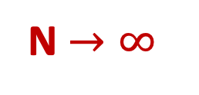

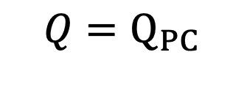

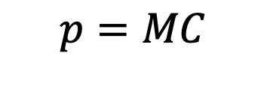

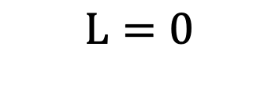
Cournot Competition
Monopolist
N=2 Firms
N=3 Firms
Q_{M}=48
p_{M}=61
L=0.79
Q_{C}=64
p_{C}=45
L=0.71
…

Slide 73
Bertrand Competition
Cournot versus Bertrand

Slide 74
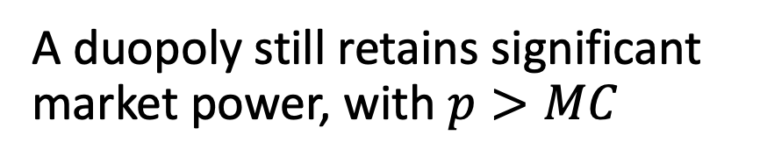
Bertrand Competition
Cournot versus Bertrand
Cournot
Adding competitors to the market slowly moves the market in the direction of perfect competition

Slide 75
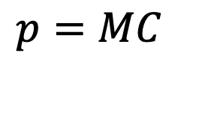
Bertrand Competition
Cournot versus Bertrand
Cournot
Bertrand
Adding competitors to the market slowly moves the market in the direction of perfect competition
Two competitors are enough to reach the perfect competition outcome

Slide 76

Duopoly Example
A duopoly faces an inverse market demand function given by P = 100 - Q, where Q = Q₁ + Q₂. Both firms
have a constant marginal cost MC = $10.
  What is Firm 1’s profit-maximizing quantity if Firm 2 produces 40 units?
  Derive the equation of each firm’s best response function.
  What is the Cournot equilibrium quantity and price in this market?
  Find the price in the market if the two firms colluded (i.e., what is the monopoly price?)
  What is the Bertrand equilibrium price in this market?

Slide 77
Cournot vs. Monopoly, which has more deadweight loss?

Slide 78
Market Structure Summary
Type | Definition | Prevalence | Example
Perfect Competition/ commoditization | Products identical, many buyers and sellers | Rare but some world markets are close | Commodities (agricultural products/ minerals), highly competitive markets
Monopolistic Competition | Firms differentiate their product | Most firms | Fast food, most consumer products
Oligopoly | Markets with a few firms. Collusion more likely. | Certain industries with high barriers to entry | Universities, airlines
Monopoly | One dominant firm | Rarely lasts long unless a natural monopoly | Companies with patents or significant competitive moats (Nvidia currently)

